Slide 1
CS 242/608 Algorithms
Week 5 Dr. Tom Schmidt

Slide 2
Week 5 Agenda
The examen
The Sounds of Sorting
Sword fight?
Radix Sort and decision-tree analysis
Some probable possibilities if time permits
Google Interview
Homework
Wrap-up and review

Slide 3
The examen
1) There are 20 students in this class who have taken a quiz so far. What is the Big O of the number of possible pairs of students in the course? What is the number of possible pairs of students in a class of 20?
2) Answer two of these three
A) Give three uses for probabilistic reasoning in Computer Science; briefly explain each.
B) There are 10,000,000 possible 7-digit positive integers. Suppose you had an array of 1 million of them. How fast would mergesort sort them? Radix Sort? Give estimates of total operations, not “nlgn”!
C) Explain why a comparison-based sort can run no faster than nlgn

Slide 4
Visualizing and audibilizing sorting
From here

Slide 5
A joust
In which the Honour and Probity of MergeSort and of Radix Sort find champions

Slide 6
Radix Sort
Decision Trees And Radix Sort and Linear Time Sorting

Slide 7
Probabilistic Modeling
Used in Machine learning
More on Probability?
Randomizing Quicksort?

Slide 8
Google Interview
A member of Teams Goethe and BMW

Slide 9
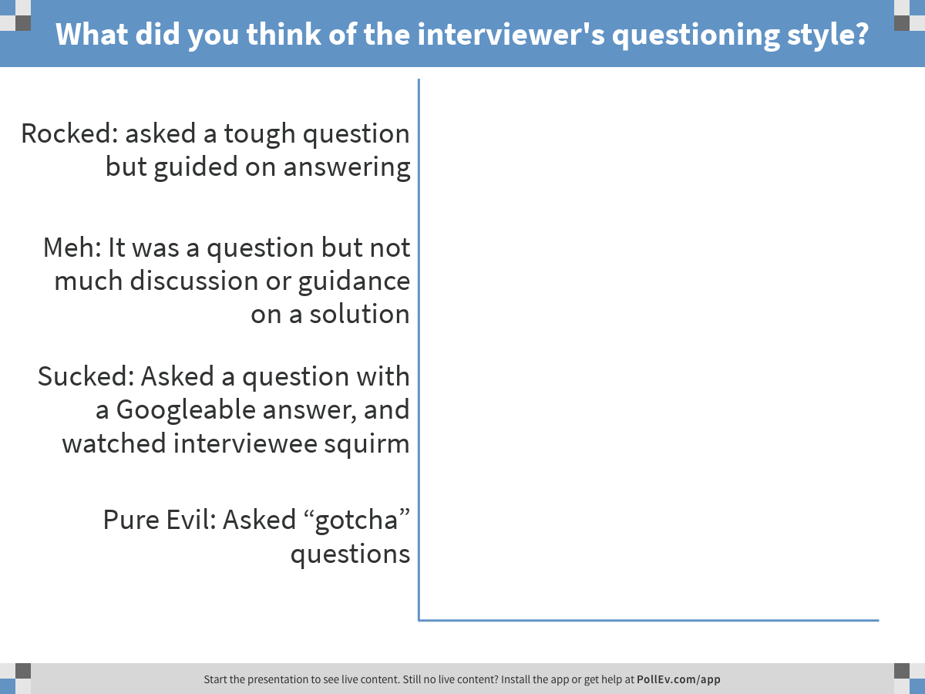
Notes:
What did you think of the interviewer's questioning style?
https://www.polleverywhere.com/multiple_choice_polls/gXPkEw1cpnly2ho

Slide 10
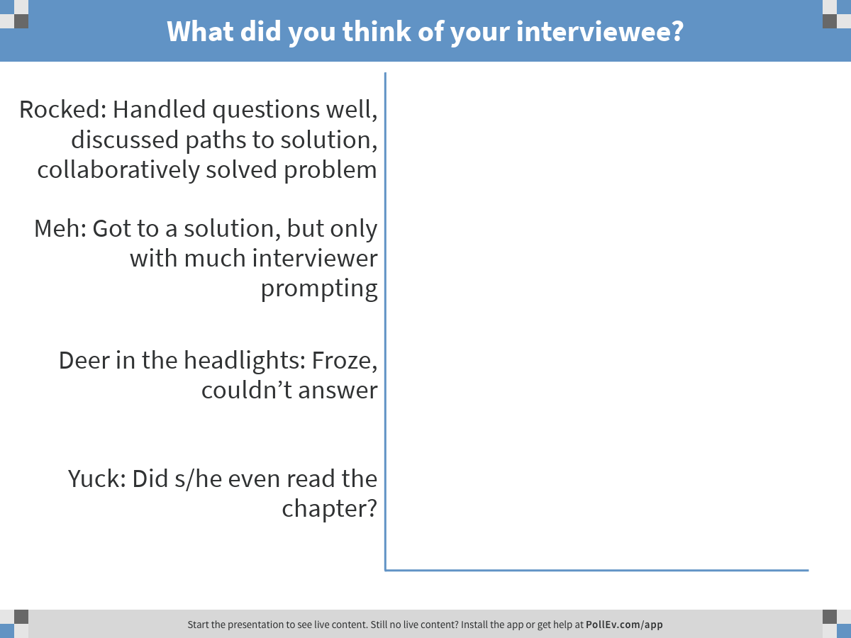
Notes:
What did you think of your interviewee?
https://www.polleverywhere.com/multiple_choice_polls/2Bcwzs8oRbfzQ4C

Slide 11
Exercise 8.1-3: Team Brandenburg

Slide 12
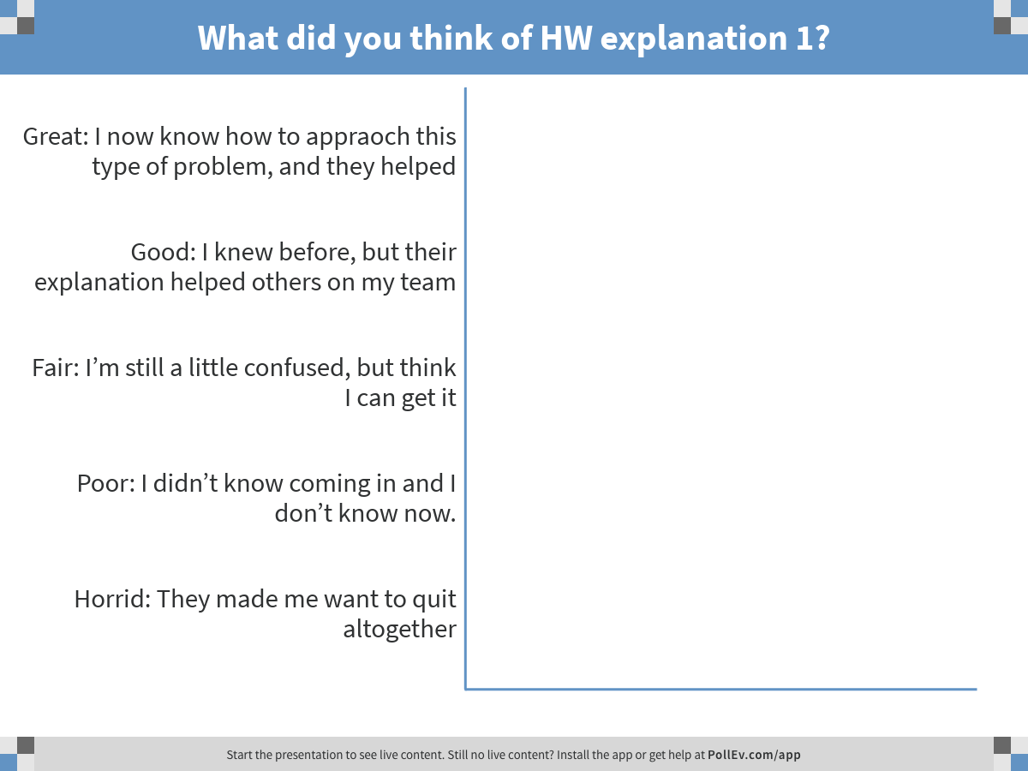
Notes:
What did you think of HW explanation 1?
https://www.polleverywhere.com/multiple_choice_polls/8vmrgZ3VhcBHQvH

Slide 13
Exercise 8.3-1 Team Neuschwanstein

Slide 14
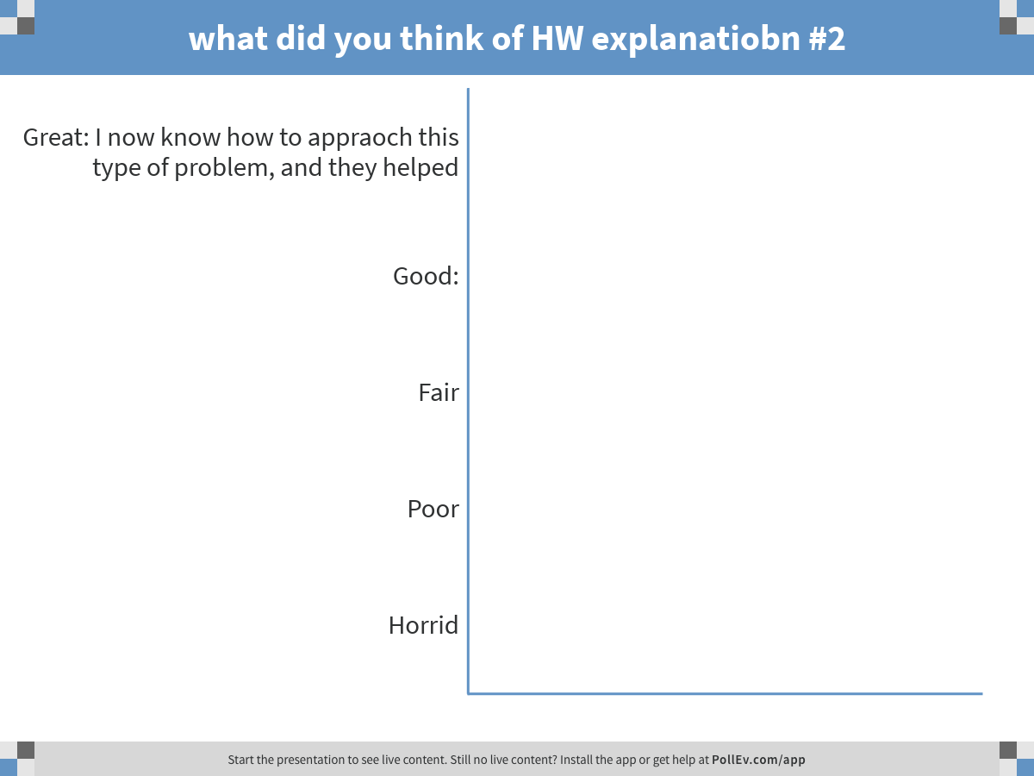
Notes:
what did you think of HW explanatiobn #2
https://www.polleverywhere.com/multiple_choice_polls/BL1zpHfb2mm0Ruz

Slide 15
Exercise 8.3-2: Team Hamburg

Slide 16
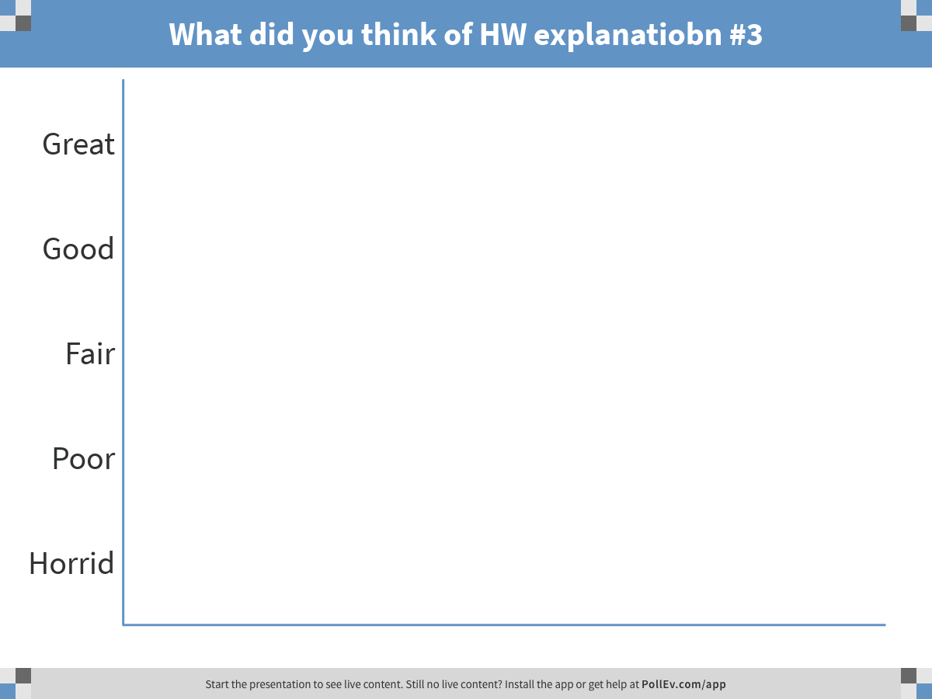
Notes:
What did you think of HW explanatiobn #3
https://www.polleverywhere.com/multiple_choice_polls/Yafw9lfl8l8gPr8

Slide 17
Wrap-up and review
Do you prefer having student explanations of homework problems?
What would make student explanations of homework problems more effective?
Thank you and Buona Notte

